Slide 1
Object Detection
Using CNTK Python API
Base Model: AlexNet
Algo: FastR-CNN

Slide 2
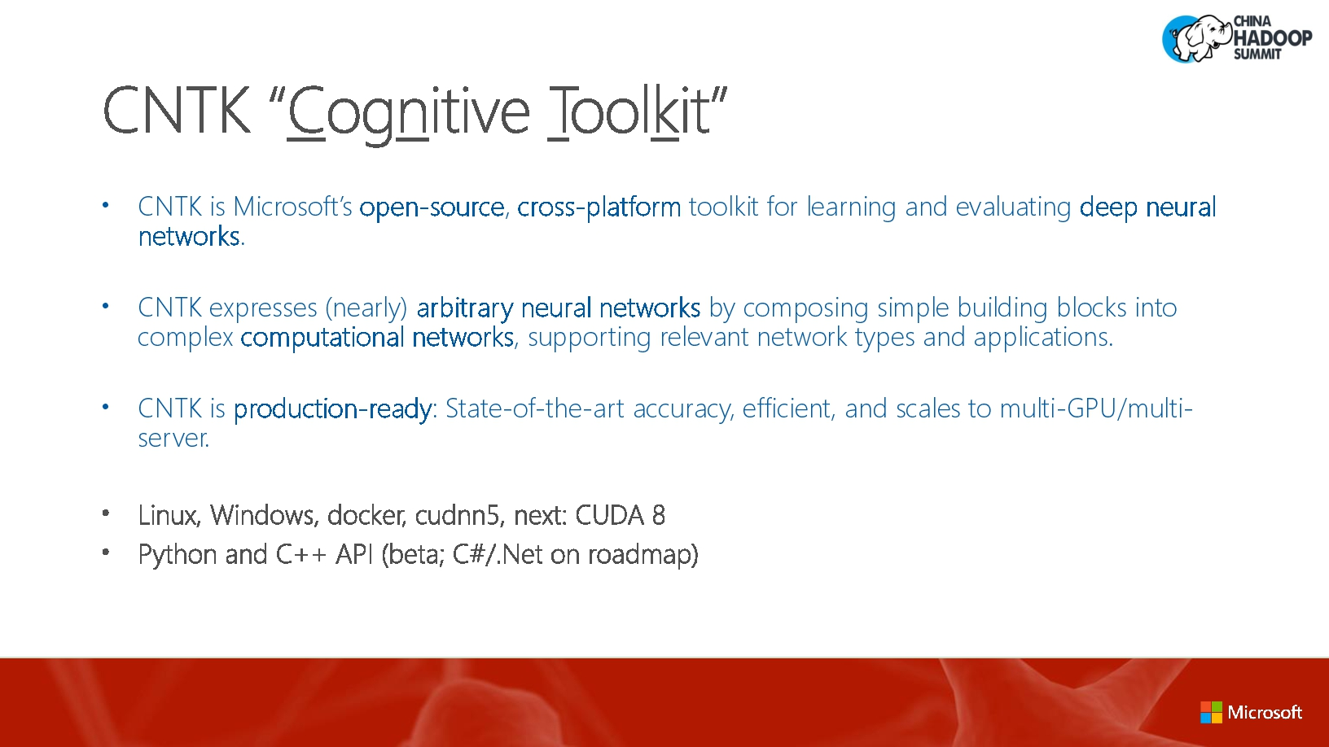
What is CNTK ?

Slide 3
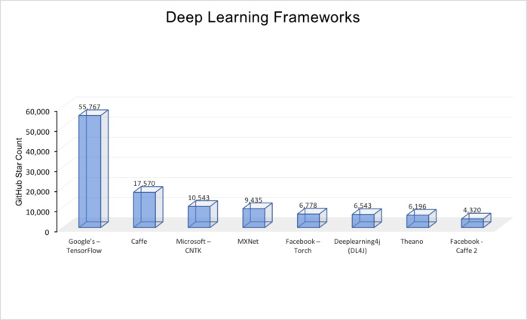
Deep Learning Frameworks
The above figure, Deep Learning Frameworks, summarizes most of the popular open source deep network repositories in GitHub. The ranking is based on the number of stars awarded by developers in GitHub. The numbers were compiled at the beginning of May of 2017.

Slide 4
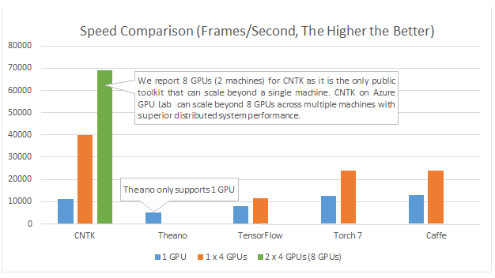
CNTK Computational Performance
CNTK can be scaled beyond single machine.
CNTK on Azure has superior distributed system performance

Slide 5
Convolutional Neural Networks have been around since early 1990s.
LeNet (1990s): First Convolutional Neural Network developed.
1990s to 2012: In the years from late 1990s to early 2010s convolutional neural network were in incubation. As more and more data and computing power became available, tasks that convolutional neural networks could tackle became more and more interesting.
AlexNet (2012) – In 2012, Alex Krizhevsky (and others) released AlexNet which was a deeper and much wider version of the LeNet and won by a large margin the difficult ImageNet Large Scale Visual Recognition Challenge (ILSVRC) in 2012. It was a significant breakthrough with respect to the previous approaches and the current widespread application of CNNs can be attributed to this work.

Slide 6
Convolutional Neural Networks have been around since early 1990s.
ZF Net (2013) – The ILSVRC 2013 winner was a Convolutional Network from Matthew Zeiler and Rob Fergus. It became known as the ZFNet (short for Zeiler & Fergus Net). It was an improvement on AlexNet by tweaking the architecture hyperparameters.
GoogLeNet (2014) – The ILSVRC 2014 winner was a Convolutional Network from Szegedy et al. from Google. Its main contribution was the development of an Inception Module that dramatically reduced the number of parameters in the network (4M, compared to AlexNet with 60M).
VGGNet (2014) – The runner-up in ILSVRC 2014 was the network that became known as the VGGNet. Its main contribution was in showing that the depth of the network (number of layers) is a critical component for good performance.
ResNets (2015) – Residual Network developed by Kaiming He (and others) was the winner of ILSVRC 2015. ResNets are currently by far state of the art Convolutional Neural Network models and are the default choice for using ConvNets in practice (as of May 2016).
DenseNet (August 2016) – Recently published by Gao Huang (and others), the Densely Connected Convolutional Network has each layer directly connected to every other layer in a feed-forward fashion. The DenseNet has been shown to obtain significant improvements over previous state-of-the-art architectures on five highly competitive object recognition benchmark tasks. Check out the Torch implementation here.

Slide 7
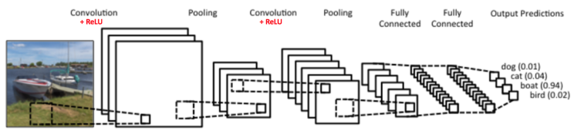
How Does CNN WorK ?
There are four main operations in the ConvNet shown in Figure
1) Convolution
2) Non Linearity (ReLU)
3) Pooling or Sub Sampling
4) Classification (Fully Connected Layer)

Slide 8
What is convolution ?
The primary purpose of Convolution in case of a ConvNet is to extract features from the input image.
Convolution preserves the spatial relationship between pixels by learning image features using small squares of input data.
The 3×3 matrix is called a ‘filter‘ or ‘kernel’ or ‘feature detector’ for 5x5 example image

Slide 9
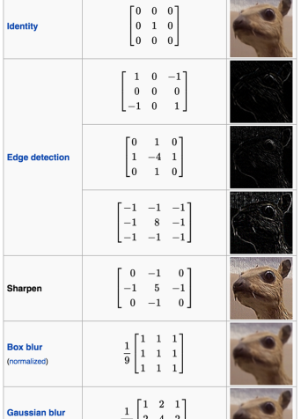
Effects of convolution with different filters
We can perform operations such as Edge Detection, Sharpen and Blur just by changing the numeric values of our filter matrix before the convolution operation

Slide 10
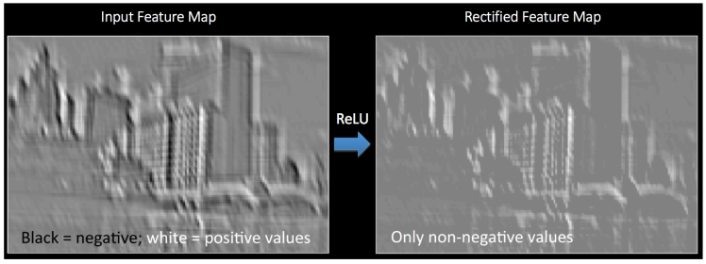
What is Non-Linearity(Relu)
ReLU is an element wise operation (applied per pixel) and replaces all negative pixel values in the feature map by zero. The purpose of ReLU is to introduce non-linearity in our ConvNet. See figure on left
Other non linear functions such as tanh or sigmoid can also be used instead of ReLU

Slide 11
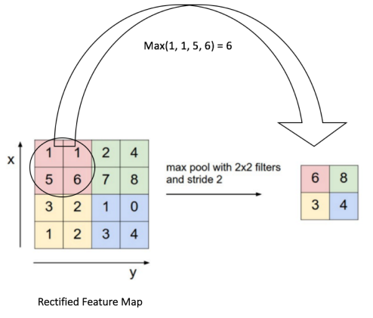
What is pooling?
Spatial Pooling (also called subsampling or down sampling) reduces the dimensionality of each feature map but retains the most important information. Spatial Pooling can be of different types: Max, Average, Sum etc.
The function of Pooling is to progressively reduce the spatial size of the input representation.

Slide 12
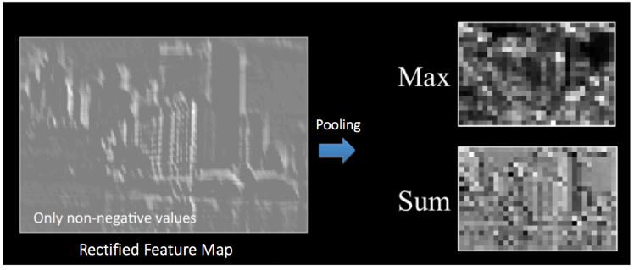
Max or Sum Pooling

Slide 13
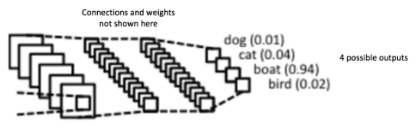
Fully Connected Layer
The Fully Connected layer is a traditional Multi Layer Perceptron that uses a softmax activation function in the output layer.
The output from the convolutional and pooling layers represent high-level features of the input image. The purpose of the Fully Connected layer is to use these features for classifying the input image into various classes based on the training dataset.

Slide 14
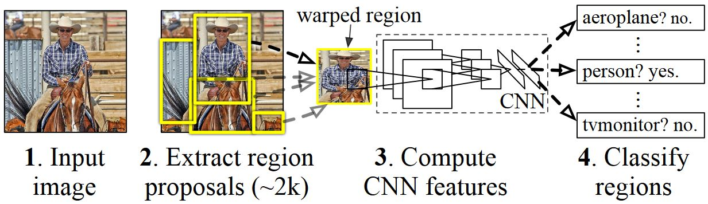
Basic Idea Behind R-CNN Algorithm
Given an input image
A large number region proposals (ROI)are generated.
These region proposals, or Regions-of-Interests (ROIs), are then each independently sent through the network which outputs a vector of e.g. 4096 floating point values for each ROI.
A classifier is learned which takes the 4096 float ROI representation as input and outputs a label and confidence to each ROI.

Slide 15
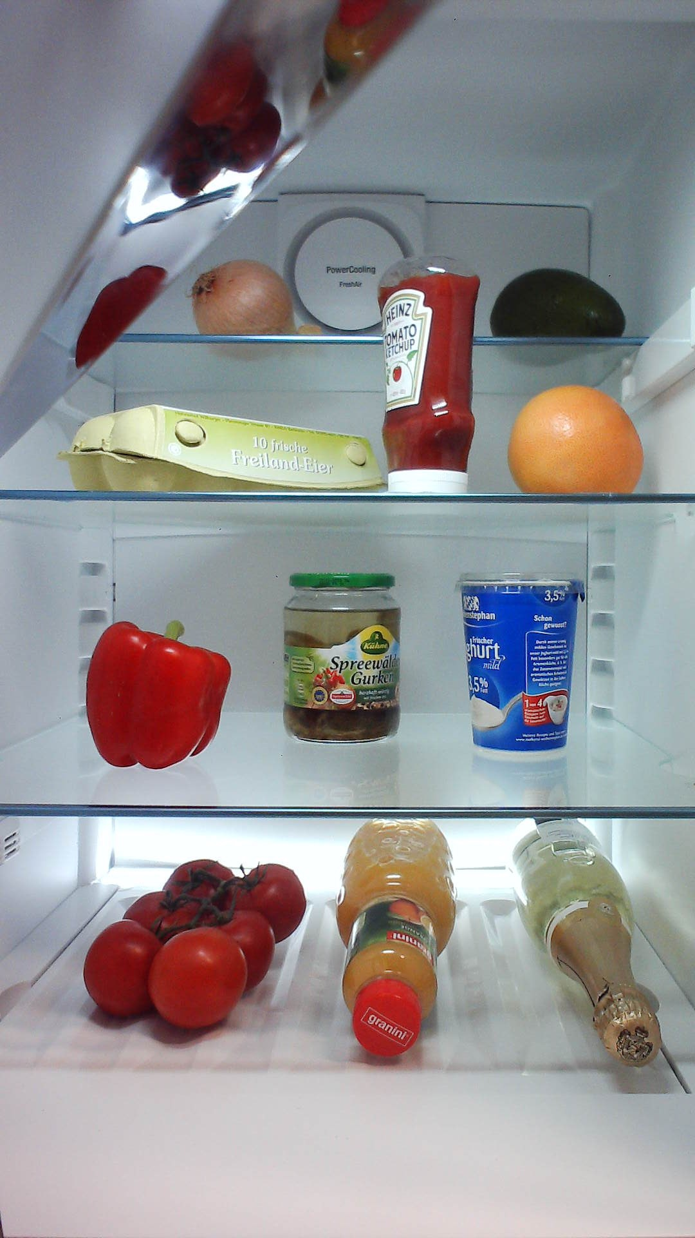
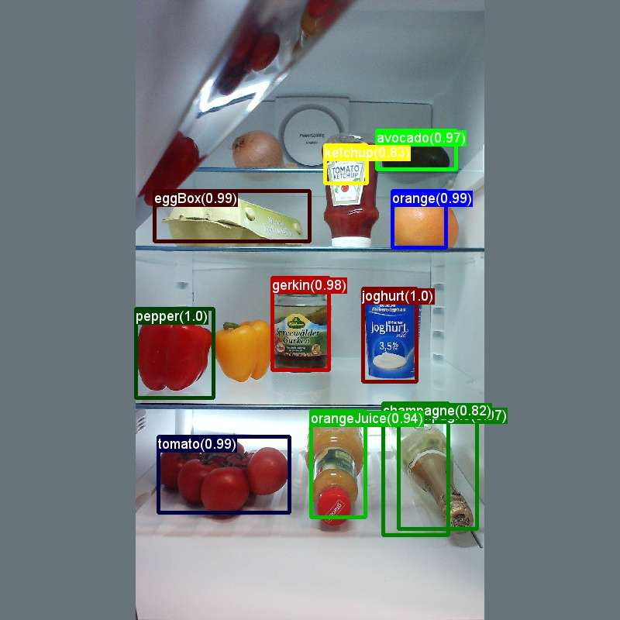
Classic Toy Example for object detection
Input Image
Output Image

Slide 16
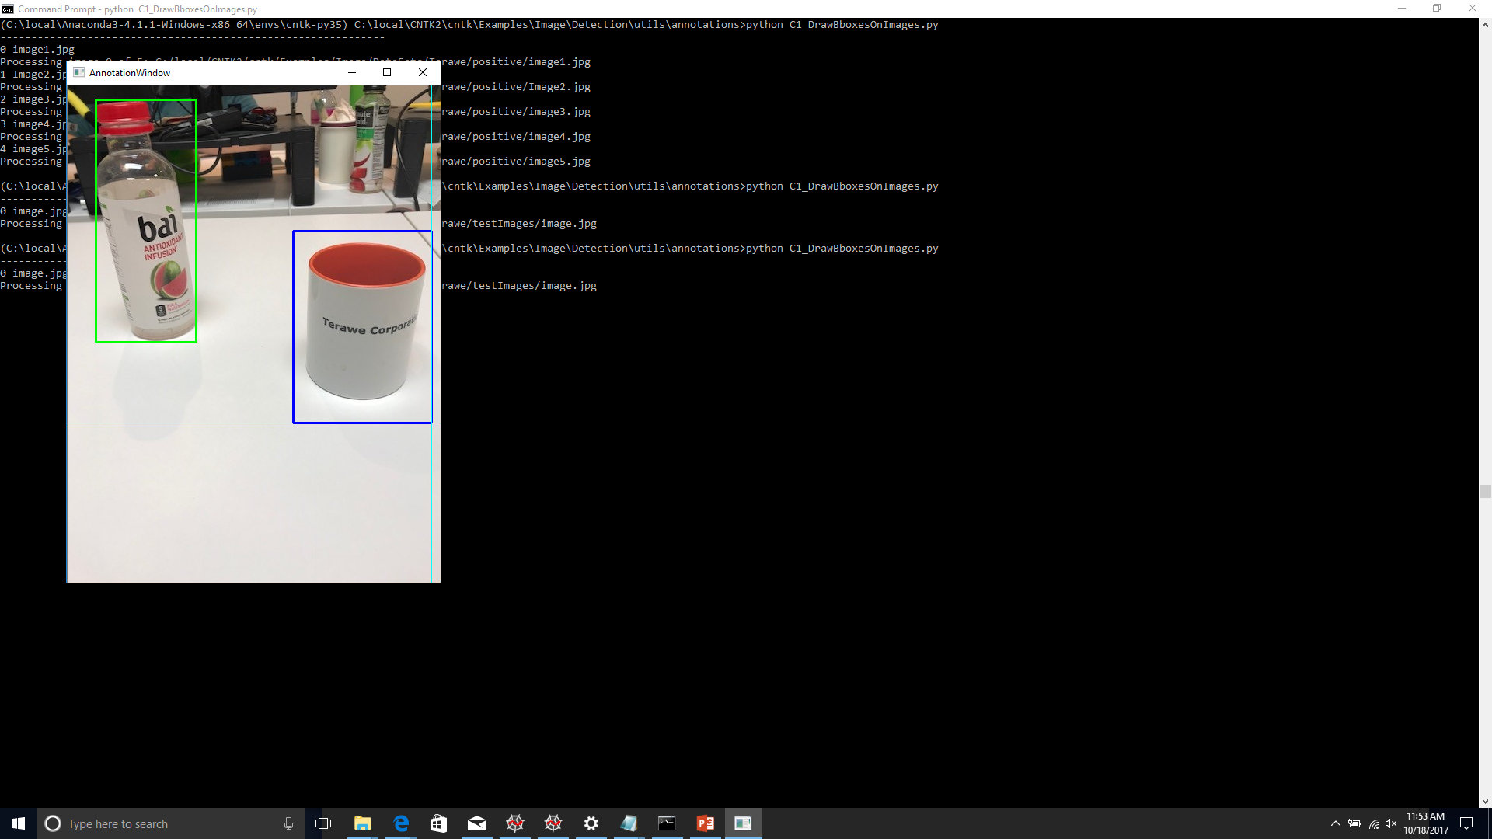
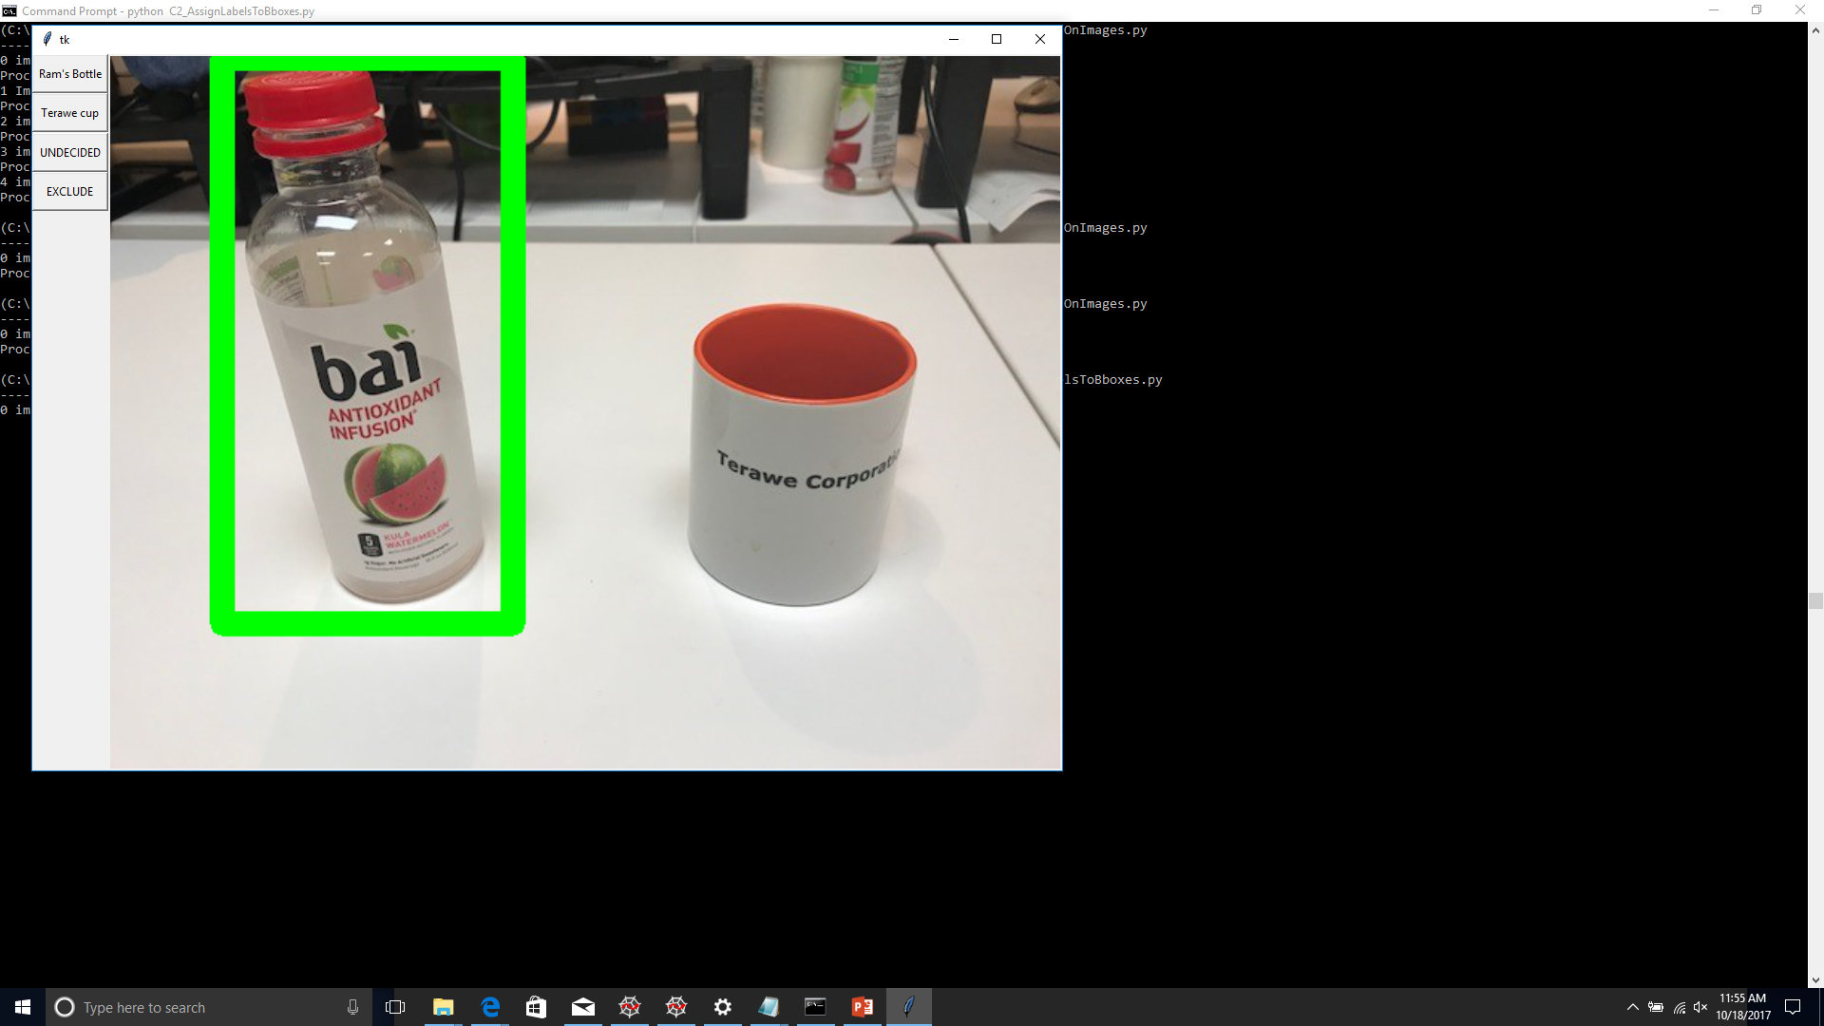
Adding boxes for ROI
Adding Labels

Slide 17
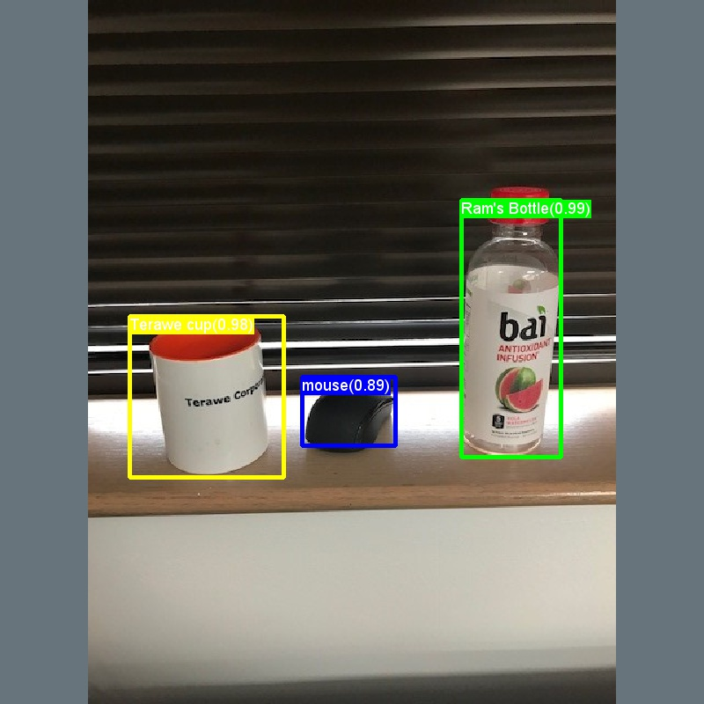
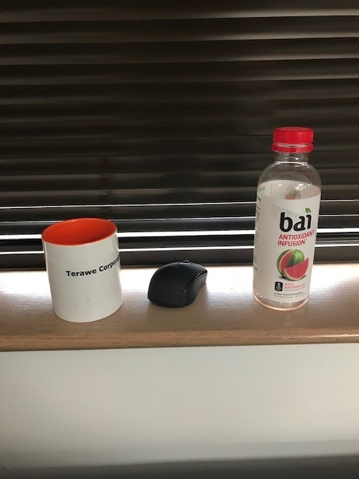
My Experiment
Input Image
Output Labeled Image

Slide 18
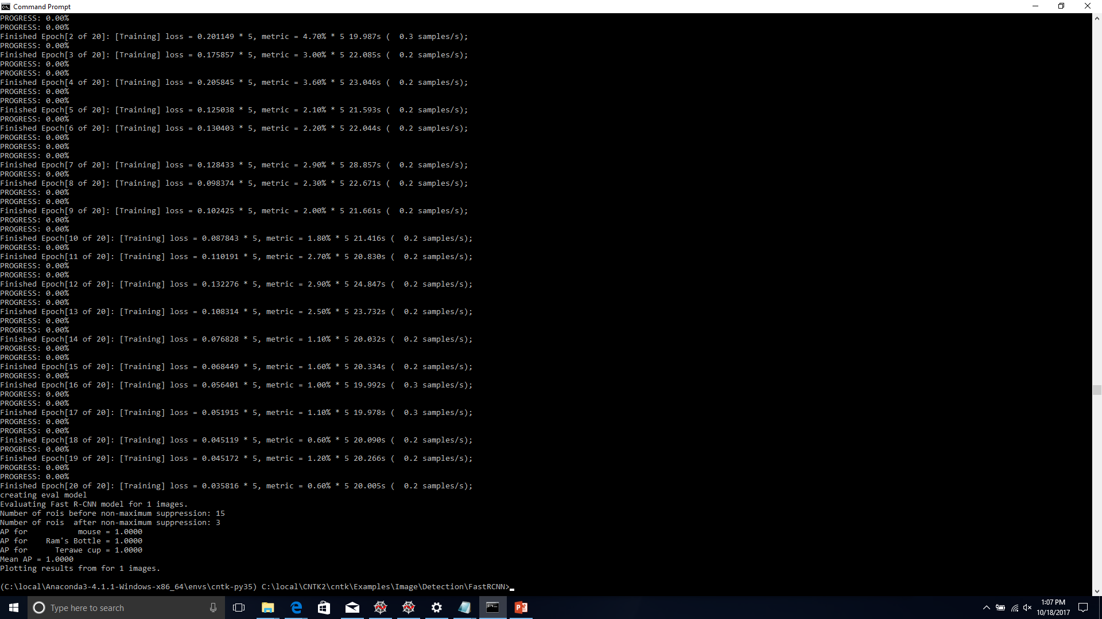
Output after running the main script

Slide 19
What’s Next ?
Using ResNets instead of AlexNet for modeling…

Slide 20
Thank you!

